Slide 2
Presented By:
Insert Name(s)
#payrollweek

Slide 3
You got a job!
On your first day of work…
You will fill out a Form W-4.
It affects how much money you take home each paycheck.
Understand it and fill it out correctly.
#payrollweek

Slide 4
You got your first paycheck!
What are all these deductions from my paycheck?
GROSS PAY
The total amount of money earned before any deductions are made.
NET PAY
The amount left after all deductions are taken out of the gross pay.
#payrollweek

Slide 5
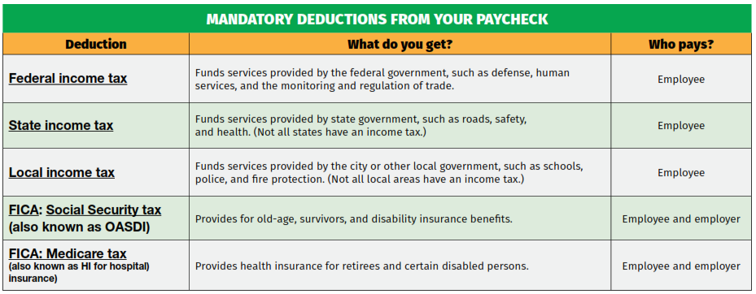
#payrollweek

Slide 6
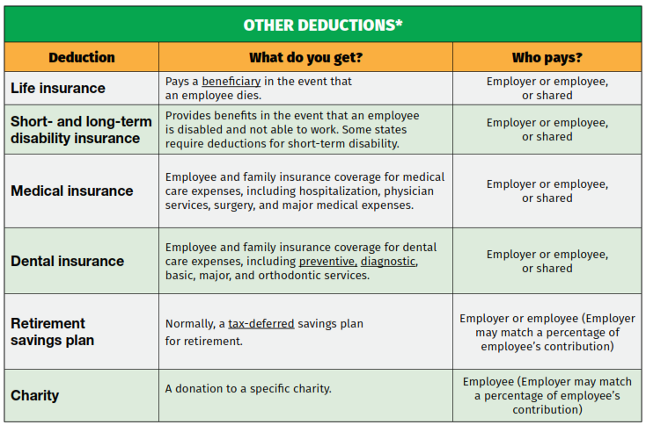
#payrollweek

Slide 7
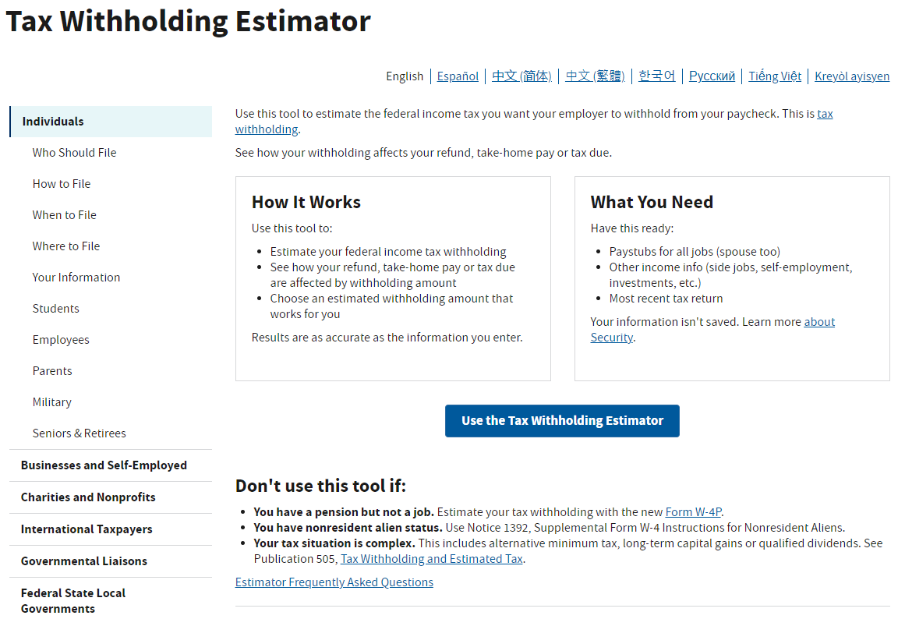
Need Help Filling out Your Form W-4?
Visit https://www.irs.gov/individuals/tax-withholding-estimator for more information.
#payrollweek

Slide 8
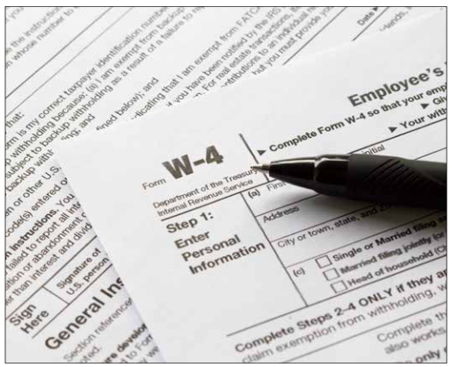
Filling Out Form W-4
EXAMPLE:
You are single,
with only one job.
#payrollweek

Slide 9
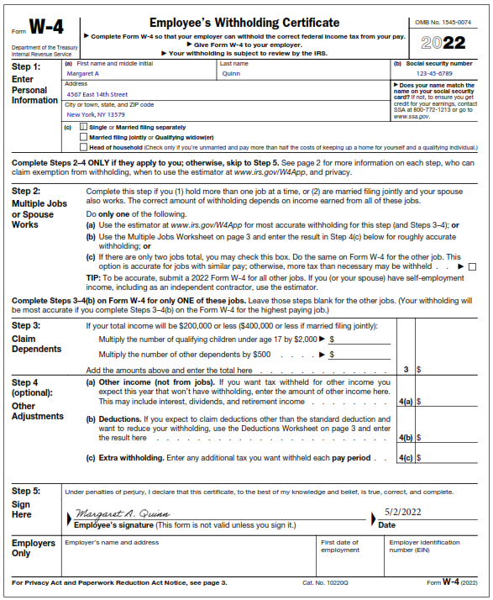
2022
Form W-4
#payrollweek

Slide 10
Questions
1. What is gross pay?
The total amount of money earned before deductions are made.
2. What is net pay?
The amount you earn after all deductions are made from gross pay.
3. True or False?
Your paycheck = Total hours worked x rate of pay?
False, deductions must still be made.
#payrollweek

Slide 11
Questions (continued)
4. Name 2 mandatory deductions.
Federal income tax
State income tax
Local income tax
Social Security tax
Medicare tax
5. Name 3 other deductions.
Life insurance
Disability insurance
Medical insurance
Dental insurance
Retirement savings plan
Contributions to charity
#payrollweek

Slide 12
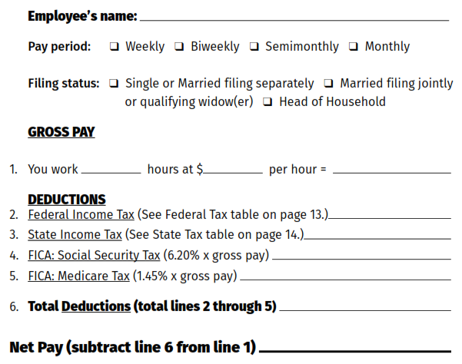
Calculating a Paycheck #1
Imagine you are a new employee at a Gourmet Coffee Shop.
Employees at the coffee shop are paid weekly.
Your filing status is single with no adjustments on your Form W-4 (you make no entries in Steps 2, 3, or 4).
You’ve worked 40 hours this week at $11/hour.
#payrollweek

Slide 13
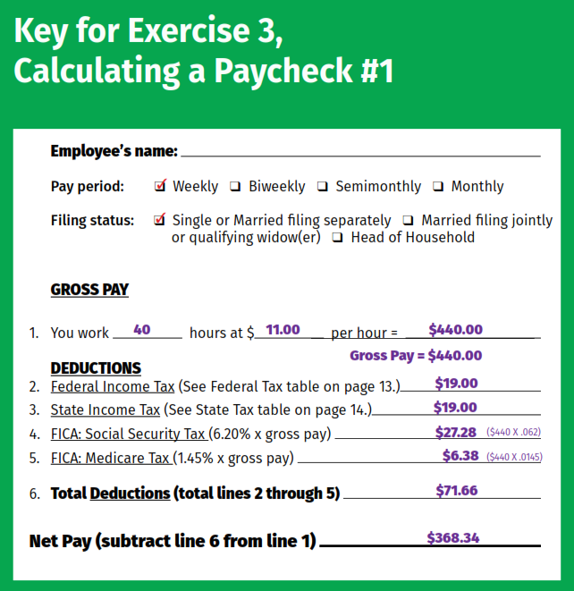
Calculating a Paycheck #1

Slide 14
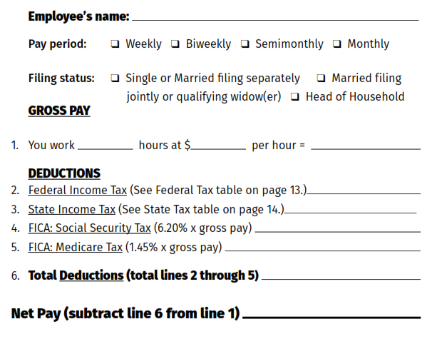
Calculating a Paycheck #2
Imagine you are a new assistant manager at a Gourmet Coffee Shop.
Employees at the coffee shop are paid weekly.
Your filing status is single with no adjustments on your Form W-4 (you make no entries in Steps 2, 3, or 4).
You’ve worked 40 hours this week at $12/hour.

Slide 15
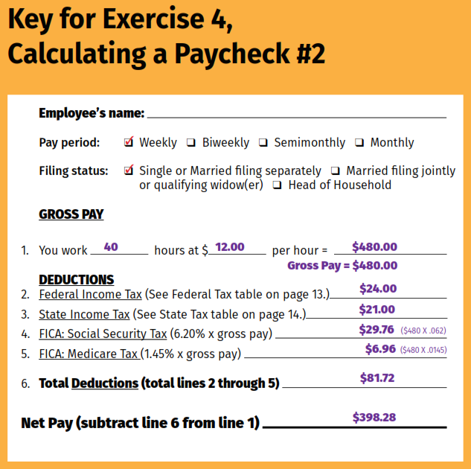
Calculating a Paycheck #2

Slide 16
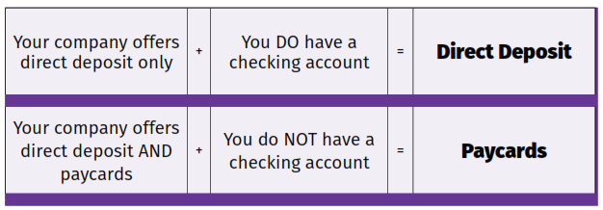
Getting Paid
Go Green With Your Green
1. Use direct deposit
2. If you don’t have a bank account, ask your company to pay you with a paycard.
#payrollweek

Slide 17
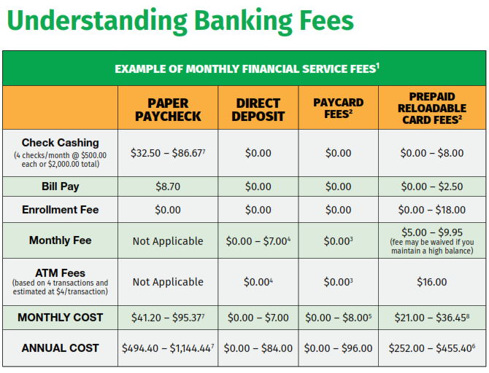
#payrollweek

Slide 18
Questions
1. Should Bobby ask to be paid differently if he opens a bank account while working for the coffee shop?
Yes, he should ask to be paid by direct deposit.
2. Valerie just opened a bank account and started working for a local restaurant that offers paycards and direct deposit. How should she ask to be paid?
She should ask to be paid by direct deposit.
#payrollweek

Slide 19
Questions (continued)
3. Emily’s company pays employees by direct deposit or paycards only. Emily doesn’t have a bank account. How should she ask to be paid?
She should ask to be paid by paycard.
#payrollweek

Slide 20
Minimum Wage
The federal minimum wage is $7.25 per hour.
What state do you live in?
* As of January 1, 2022, 30 states and the District of Columbia have a minimum wage rate higher than the federal minimum wage.
#payrollweek

Slide 21
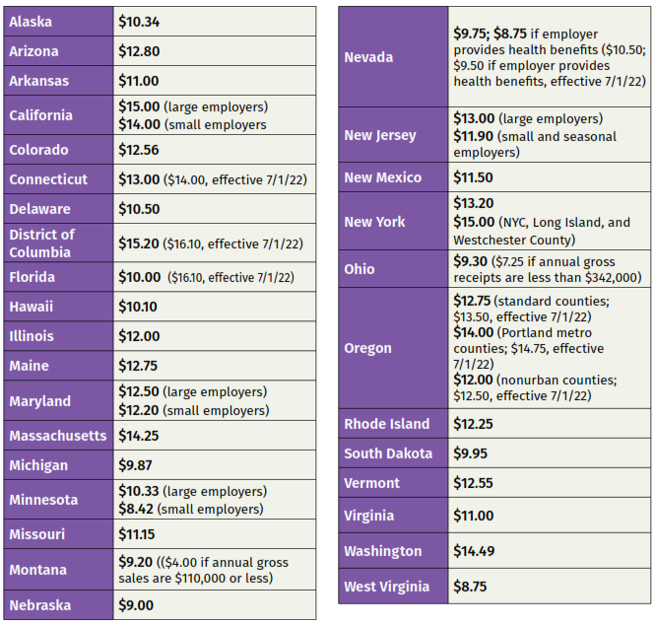
State Minimum Wages
#payrollweek

Slide 22
Overtime Pay
By federal law, your employer is required to pay an overtime rate of at least 1.5 times your regular pay for all hours worked over 40 in one week.
Example:
You work 48 hours in one week at 11 per hour.
$11 per hour x 48 hours = $528
$11 per hour x 8 hours x .5 = $44
Gross Pay = $528 + $44 = $572
#payrollweek

Slide 23
#payrollweek

Slide 24
For more information, log on to: www.nationalpayrollweek.com
#payrollweek

